Slide 1
CS:GO win/loss prediction for better gameplay and user retention
Gautam Baghel
Aug 7, 2018

Slide 2

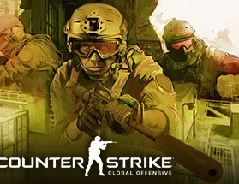
Introduction
is a multiplayer first-person shooter videogame.
The game pits two teams against each other: the Terrorists and the Counter-Terrorists.

Slide 3
Problem
We want to maximize the user retention on valve servers and give the players a good gaming experience
The way to do that is two-fold: Matches are evenly established. Secondly, there are no cheaters
Valve runs Valve Anti-Cheat to prevent cheating.
So this project will be focusing on better matchmaking.

Slide 4
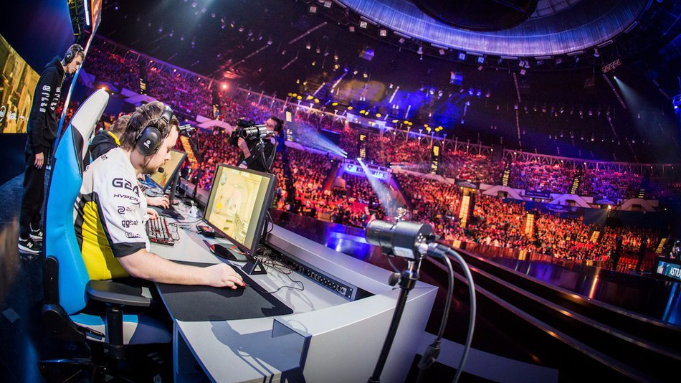
Why this topic and project ?
In modern culture, besides physical sports, electronic sports also contribute to the competitive but highly influenced athletics community, especially the multi-player online battle arena games.
Players have made careers out of playing professional MOBA games with earnings in the range of a million dollars annually.
Electronic sports (eSports) are so influenced among young people that game developers feel bigger responsibility on improving the game and create a more enjoyable but fair game arena.

Slide 5




MY APPROACH
Read the data
Millions of data files available on valve API
Parse the file
Include the things relevant to the research and clean the data.
Fit into algorithm
Use predefined set of H2o Ai, Python notebooks functions to predict
Test
Use 10 fold cross validation to check whether the results are consistent

Slide 6
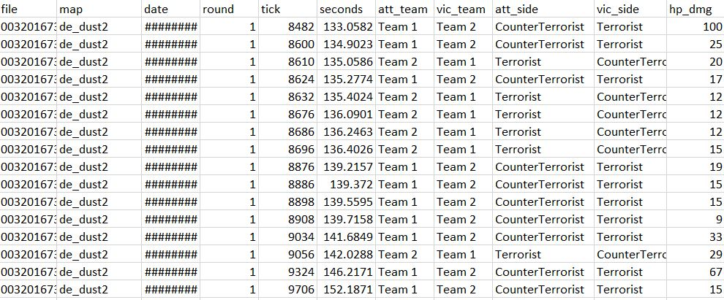
Initial data needed to be cleaned and converted from JSON to csv
Final data(Parsed)
4
3
Do Feature selection and remove correlated features
2
Within features,
figure out the
missing parameters
1
Take the data
DATA PARSING

Slide 7
Techniques Used
GLM: Good fit r2 : 84%
MSE, RMSE: below 1%
1
-------------
2
GBM: CT shown to be more dominant side
Different Machine learning models used
-------------
3
Naïve Bayes: cond variables for every feature
-------------
Deep Learning: ~70% accuracy
4
-------------
5
Stack Ensemble: more combinations left to try, current accuracy ~72%
-------------

Slide 8
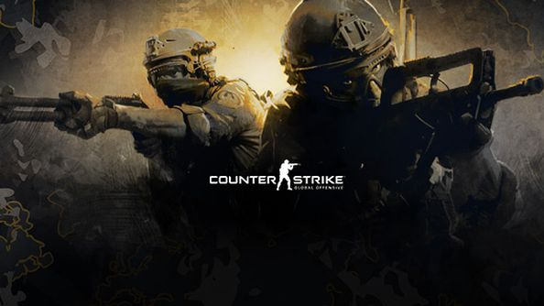
RESULTS
1
Significance
Three to four percent improvement in matchmaking doesn’t seem significant but in a high league game where stakes are high it will make a huge difference. Who cares? Company does, to keep players satisfied and hooked riot ensures that players get involved with each other.
2
Correctness
To be sure the result we got are valid for every prediction made a 10 fold cross validation is performed.
3
Factors not considered
The dataset also included lots of positional data based on maps and movement of players within that map which could’ve been another feature.

Slide 9






CONCLUSION AND WHAT I WANTED TO INCLUDE
Features that are important in win/loss DONE!
Matchmaking criterion and correlation shown
Work to be done, valve’s internal mechanisms may affect results
Identify potential matches which are pre-fixed
Somehow include Game theory into this!
Work in progress for stack ensemble
Free PowerPoint Templates

Slide 10
END
QUESTIONS OR COMMENTS ??
Thank you !

